Slide 1
Survival analysis
CHAPTER 7

Slide 2
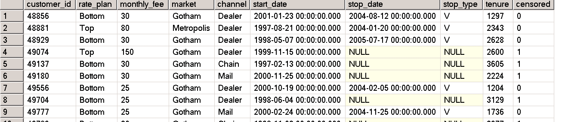
Turime 5068035 įrašų lentelėje subs.
SELECT * FROM [sqlbook].[dbo].[subs]
Kokie tai duomenys ? Pamėginkime sukurti istoriją žiūrėdami tik į duomenis.
Klientas kurio id=48856 pasirinko planą Bottom kas reiškia, kad jis mokės kas mėnesį 30 $. Klientas priklauso Gotham regionui (fikcinis miestas iš betmano komiksų , tad darom išvadą kad duomenys pakeisti siekiant juos nuasmeninti). Kanalas kuriuo buvo pritrauktas klientas yra Dealer. Klientas užregistruotas 2001-01-23. 2004-08-12 klientas nutraukė sutartį. Nutraukimo priežasties tipas V nelabai ką mums sako. Klientas naudojosi paslaugomis 1297 dienas. Censored atributas rodo kad mes žinome tiksliai kad klientas nutraukė sutartį (1 reikštų, kad nenutraukė).

Slide 3
Step 1. Create the Survival Table
The following SQL creates the survival table:
CREATE TABLE [tempdb].[dbo].[survival] (
tenure INT,
popt INT,
stopt INT,
cumpopt INT,
hazard FLOAT,
survival FLOAT,
endtenure INT,
numdays INT
)

Slide 4
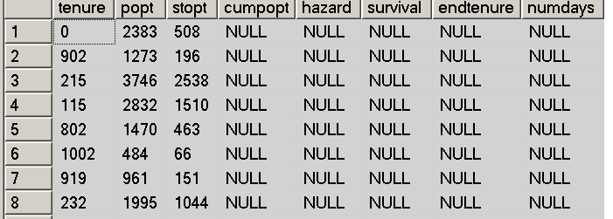
Step 2: Load POPT and STOPT
Tenure – laikotarpis kurį klientas aktyvus (dienomis)
Popt – Kiek klientų su tokiu laikotarpiu
Stopt – Kiek klientų su tokiu laikotarpiu nutraukė kontraktą
INSERT INTO [tempdb].[dbo].[survival]
SELECT tenure,
COUNT(*) as popt,
SUM(CASE WHEN stop_type IS NOT NULL THEN 1 ELSE 0 END) as stopt,
NULL as cumpopt, NULL as hazard, NULL as survival,NULL as endtenure, NULL as numdays
FROM [sqlbook].[dbo].[subs]
WHERE start_date >= '2004-01-01' AND tenure >= 0
GROUP BY tenure
ORDER BY tenure

Slide 5
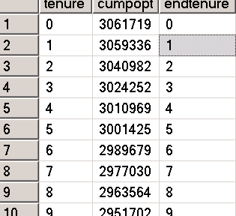
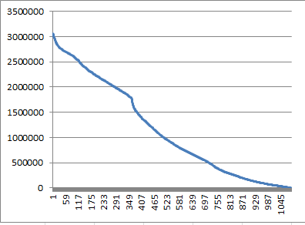
Step 3: Calculate Cumulative Population
SELECT s1.tenure, SUM(s2.popt) as cumpopt, MIN(CASE WHEN s2.tenure > s1.tenure THEN s2.TENURE-1 END ) as endtenure
INTO ##KiekKlientuKiekvienamTermine
FROM [tempdb].[dbo].[survival] s1 LEFT OUTER JOIN
[tempdb].[dbo].[survival] s2 ON s1.tenure <= s2.tenure
GROUP BY s1.tenure
ORDER BY s1.tenure
SELECT * FROM ##KiekKlientuKiekvienamTermine
Cumpopt- kiek klientų išliko iki konkretaus termino.
ENDTENURE – tas pats kas tenure ; beprasmis stulpelis

Slide 6
Step 3: Calculate Cumulative Population
UPDATE [tempdb].[dbo].[survival]
SET survival.cumpopt = ssum.cumpopt, survival.endtenure = ssum.endtenure
FROM ##KiekKlientuKiekvienamTermine ssum
WHERE survival.tenure = ssum.tenure
Perkeliam savo paskaičiavimus iš tarpinės lentelės ##KiekKlientuKiekvienamTermine
į savo pagrindinė tarpinę lentelę [tempdb].[dbo].[survival]

Slide 7
Step 3: Calculate Cumulative Population
The next step is to calculate the cumulative population and ENDTENURE. The
self-join query that calculates these columns is:
The challenge is expressing this as an update statement. This is a challenge because this query is updating the same table that’s generating the values.
UPDATE [tempdb].[dbo].[survival]
SET survival.cumpopt = ssum.cumpopt, survival.endtenure = ssum.endtenure
FROM (SELECT s1.tenure, SUM(s2.popt) as cumpopt, MIN(CASE WHEN s2.tenure > s1.tenure THEN s2.TENURE-1 END ) as endtenure
FROM [tempdb].[dbo].[survival] s1 LEFT OUTER JOIN
[tempdb].[dbo].[survival] s2 ON s1.tenure <= s2.tenure
GROUP BY s1.tenure) ssum
WHERE survival.tenure = ssum.tenure
Cumpopt- kiek klientų išliko iki konkretaus termino.
ENDTENURE – tas pats kas tenure ; beprasmis stulpelis
Čia tas pats kas prieš tai 2 skaidrėse. Skirtumas kad viskas padaryta su vienu SQL sakiniu.

Slide 8
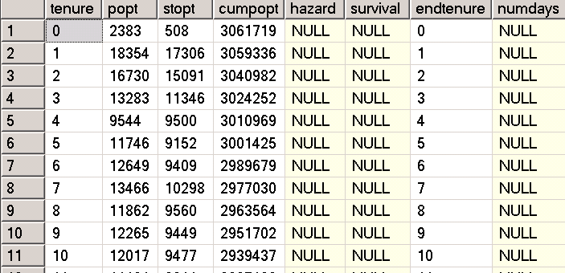
SELECT * FROM [tempdb].[dbo].[survival]
Pamėginkime sukurti istoriją žiūrėdami tik į duomenis.
Įrašas Nr 6. Turime klientus, kurių prenumerata truko tik 5 dienas. Tokių klientų 11746. Iš jų 9152 nutraukė sutartį. Reiškia likę yra aktyvūs.
Matome , kad turime 3010969 klientus, kurių prenumerata buvo 5 ar daugiau dienas.

Slide 9

Step 4: Calculate the Hazard
The next step is to calculate the hazard probability and NUMDAYS:
UPDATE [tempdb].[dbo].[survival] SET survival.hazard = stopt*1.0 / cumpopt,
survival.numdays = endtenure - tenure + 1
Formulėje skaitiklyje klientų skaičius nutraukė sutartį išbuvę klientais tam tikrą fiksuotą laikotarpį (*1.0 tam kad gauti float tipo skaitiklį).
Vardiklyje visas klientų skaičius kurie išbuvo aktyviais daugiau nei tenure laikotarpis .
Numdays – visur bus vienas (nelabai aišku kam mums jo reikia).

Slide 10
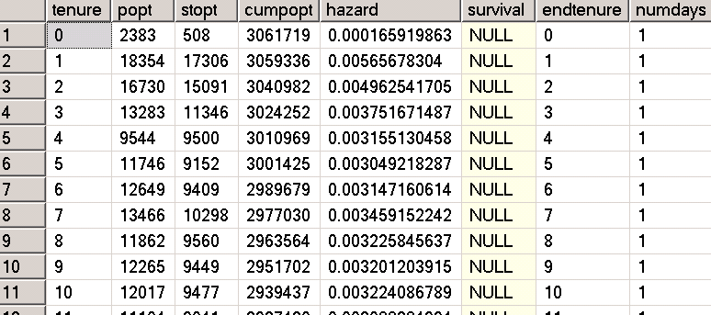
SELECT * FROM [tempdb].[dbo].[survival]
Pamėginkime pratęsti istoriją žiūrėdami tik į duomenis.
Įrašas Nr 6. matome, kad hazard=0.003049... Tai dydis gautas padalinant 9152/3001425 t.y. klientų skaičių kurie nutraukė sutartį po 5 dienų iš klientų skaičiaus kurie išlaikė sutartį daugiau lygu kaip 5 dienas. Tai galime interpretuoti kaip:
Kokia tikimybė, kad klientas nutrauks sutartį po penkių dienų.

Slide 11
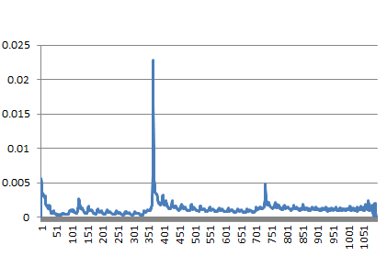
SELECT tenure, hazard FROM [tempdb].[dbo].[survival] ORDER BY tenure

Slide 12
Step 5: Calculate the Survival
The survival calculation is another accumulation, but this time a product
instead of a sum. What we are trying to do is to add survival as a column using
logic such as the following:
UPDATE [tempdb].[dbo].[survival]
SET survival =
(CASE WHEN tenure = 0 THEN 1
ELSE (SELECT EXP(SUM(LOG(1-hazard)))
FROM [tempdb].[dbo].[survival] s2
WHERE s2.tenure < survival.tenure
)
END)

Slide 13
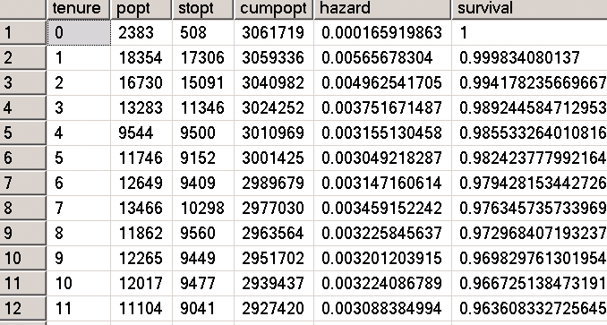
SELECT * FROM [tempdb].[dbo].[survival]
Įrašas Nr 6. matome, kad survival=0.9824... Tai galime interpretuoti kaip:
Kokia tikimybė, kad klientas išbus daugiau nei 5 dienos.

Slide 14
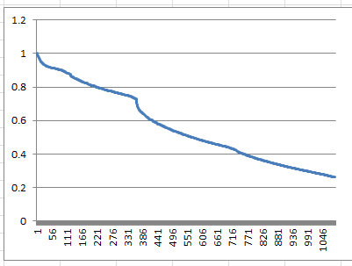
SELECT tenure, survival FROM [tempdb].[dbo].[survival] ORDER BY tenure

Slide 16
Survival analysis
Survival analysis is a branch of statistics that deals with analysis of time duration until one or more events happen, such as death in biological organisms and failure in mechanical systems. This topic is called reliability theory or reliability analysis in engineering, duration analysis or duration modelling in economics, and event history analysis in sociology.
Survival analysis attempts to answer questions such as:
what is the proportion of a population which will survive past a certain time?
Of those that survive, at what rate will they die or fail?
Can multiple causes of death or failure be taken into account?
How do particular circumstances or characteristics increase or decrease the probability of survival?

Slide 17
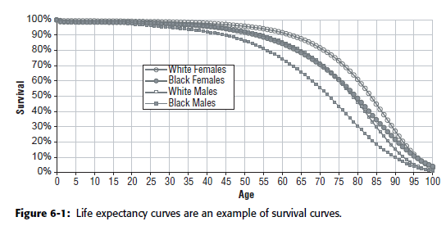
The object of primary interest is the survival function, conventionally denoted S, which is defined as
where t is some time, T is a random variable denoting the time of death, and "Pr" stands for probability.

Slide 18
The hazard function, conventionally denoted ,
is defined as the event rate at time t
conditional on survival until time t or later (that is, T ≥ t),
Survival is the probability that someone survives to a given point in time. A
related concept, the hazard, is the probability that someone succumbs to a
risk at a given point in time.
The long-term trend in the hazard probabilities is a good measure of
loyalty, because it shows what happens as customers become more familiar
with you.

Slide 19
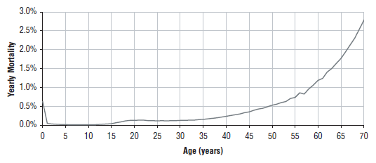
Two examples of hazard probability curves.
The chart in Figure is the overall risk of dying, based on the 2003 data
for the U.S. population. This chart shows the risk at yearly intervals, and
reveals interesting facts.

Slide 20
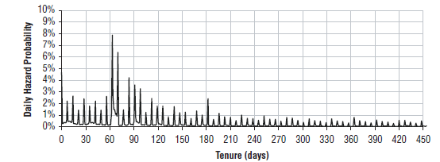
The chart in Figure shows the more complicated hazard probabilities
for the risk of customers stopping a subscription a certain number of
days after they start. This chart also has several features. First, the hazard at
tenure 0 is quite high because many customers are recorded as starting but are
not able to start—perhaps their credit cards didn’t go through, or their
addresses were incorrect, or they immediately changed their mind. There are
another two peaks between 60 and 90 days out. These peaks correspond to
customers not paying and to customers stopping after the end of the initial
promotional period.

Slide 22
Survival Analysis with R
https://en.wikipedia.org/wiki/Survival_analysis
https://www.r-bloggers.com/survival-analysis-with-r/

Slide 23
Survival Analysis with R

Slide 24
Survival Analysis with R

